Slide 1

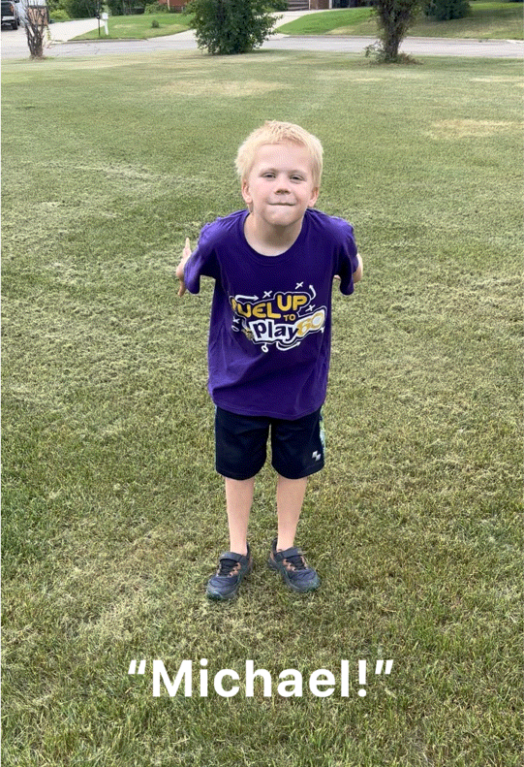
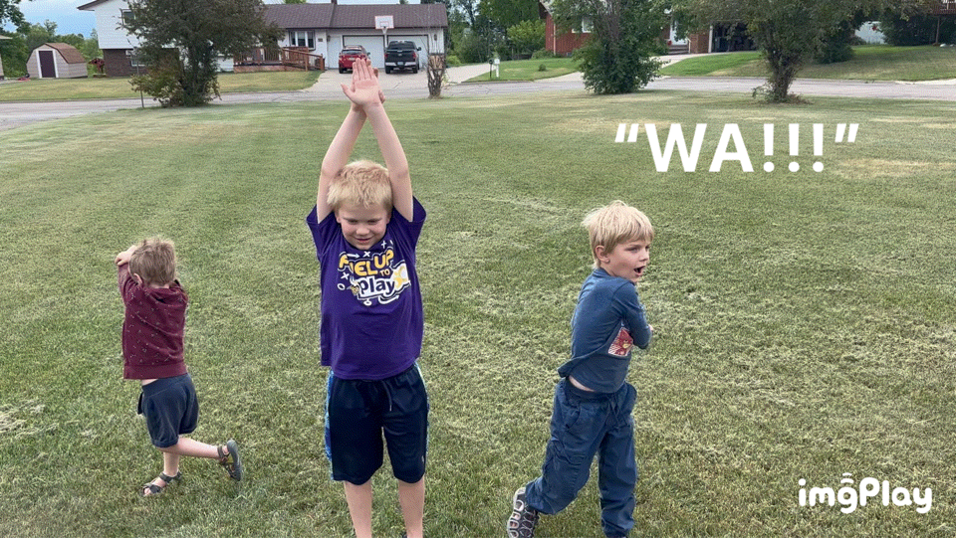
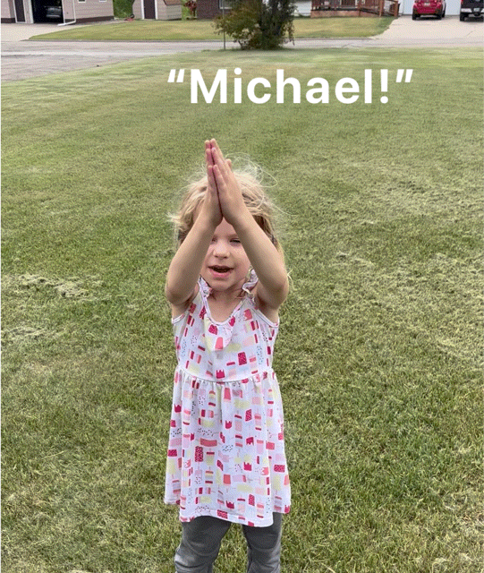
Wa Name Game: Students stand in a circle.
This game has three actions on three consecutive beats and continues repeatedly. It is a great way to learn student names.
Beat three
the two people next to the person that has their hands raised make a chopping motion towards the stomach of the person with their hand raised.
Beat One swinging arms down and pointing at a person while saying their name.
Beat two
that person raises their hands and repeats their own name.

